Slide 1
NYC Rent Policy Analysis
Free Market vs Rent Regulation
Joao De Oliveira
DATA 607, CUNY SPS
Fall 2025
Notes:
I analyzed historical rent trends in Manhattan using Zillow ZORI and HUD Fair Market Rent data, and modeled how rents might change under free-market conditions compared to rent stabilization or a rent freeze. The goal is to understand how policy choices can impact affordability in a high-cost city like New York.

Slide 2
Motivation - Why this topic?
01
02
03
04
NYC rents have risen sharply over the past decade
Rent affordability is a major policy concern
Manhattan is one of the most expensive housing markets in the U.S.
How much would rent change if NYC implemented rent stabilization or a freeze?
Notes:
I chose this topic because rent increases in NYC, especially Manhattan, have been dramatic and affect affordability and displacement.
Policy debates often lack clear quantitative comparisons, so I wanted to model what rent trends might look like under different policy scenarios — including a rent freeze or rent stabilization cap.

Slide 3
Data Sources
Zillow ZORI (Observed Rent)
HUD Fair Market Rent (FMR)
Monthly rent index by ZIP code
Used ZIPs from Manhattan
Aggregated to annual average values
Annual 1 BR FMR values for all counties
Extracted New York county (Manhattan)
Covers 1983-2025
Notes:
For data sources, I used two independent datasets:
Zillow’s ZORI, which measures typical market rents monthly at the ZIP-code level, and HUD’s Fair Market Rent dataset, which provides an annual estimate of typical rents at the county level.
These two datasets complement each other — one gives detail and the other gives an official standardized measure.

Slide 4
Data Processing Steps
Cleaned column names with {janitor}
Converted ZORI wide monthly columns to long format
Parsed data strings
Extracted Manhattan ZIP codes
Aggregated ZORI values to yearly means
Filtered HUD dataset for New York County, NY
Merged both datasets by year
Notes:
Most of the work in this project was data cleaning.
ZORI comes in a very wide format with dates as column names, so I had to pivot and clean those into usable dates.
HUD’s dataset included all counties in the U.S., so I extracted only New York County.
After aligning both datasets by year, I had a clean dataset ready for modeling.

Slide 5
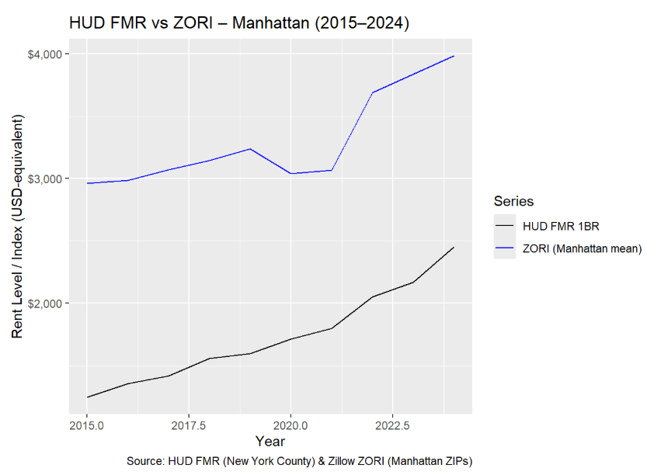
Exploratory Trends
Manhattan Rent Trend (2015-2024)
Rents show a consistent upward trend
HUD FMR and ZORI track each other closely
Manhattan remains one of the highest cost rental markets in the U.S.
Notes:
The exploratory analysis showed a clear upward trend.
Both ZORI and HUD FMR move together, validating each other.
This suggests a strong, consistent pattern of rent increases in Manhattan year to year.

Slide 6
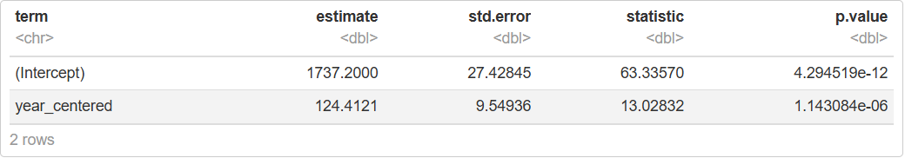
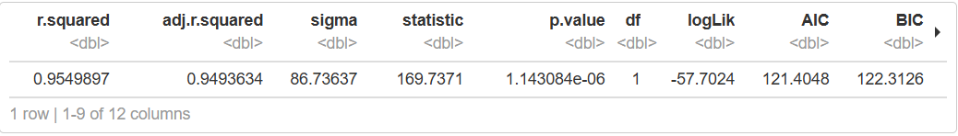
Regression Model
Linear Model: FMR_1BR ~ year_centered
Annual increase: around $124 per year
R²: 0.955
Highly significant trend (p < 0.001)
Notes:
I fit a simple linear regression model using FMR as the outcome and time as the explanatory variable.
The model estimates that rents increased by about $124 per year, and the R² of 0.955 shows the model fits extremely well.
This gives us a strong basis for projecting future rent levels under current trends.

Slide 7
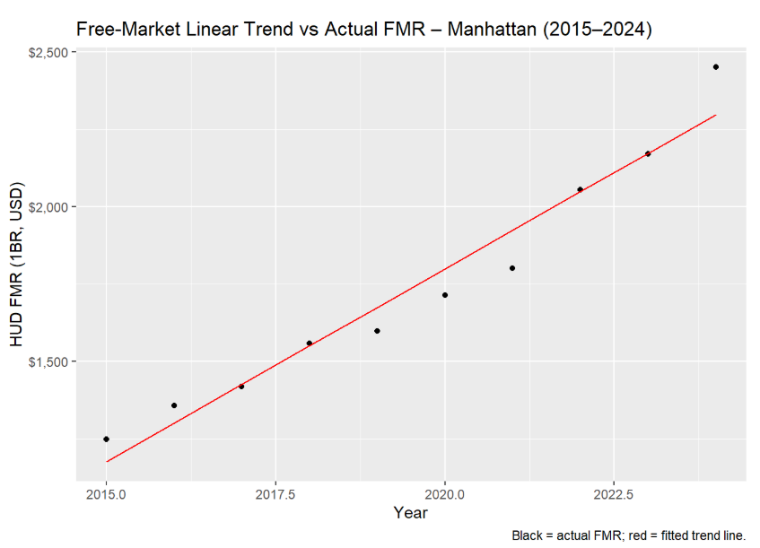
Model fit vs Actual Data

Slide 8
Policy Scenarios
I projected rents to 2030 under three scenarios:
Free Market (continue historical trend)
1% Rent Stabilization Cap
Rent Freeze
Notes:
I then used the model to create hypothetical policy scenarios.
This is not meant to be causal modeling — it’s a simple scenario-based projection that helps visualize possible outcomes of different rent policies.

Slide 9
2030 Projection Results
Manhattan 1 BR in 2030
Free Market | $3,043
1% Rent Stabilization | $2,601
Rent Freeze | $2,451
Notes:
Under a free-market path, rents reach just over $3,000 by 2030.
With a 1% cap, rents would be about $2,602, or almost $450 lower.
With a full freeze, rents remain at the 2024 level, nearly $600 below the free-market scenario.

Slide 10
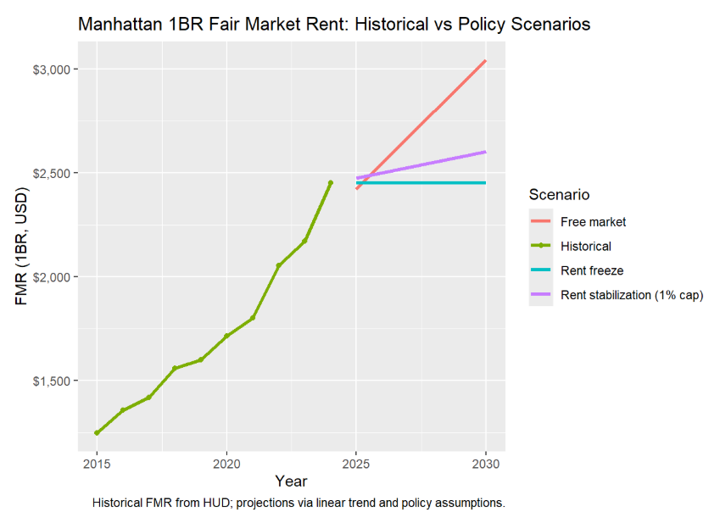
Free Market vs Rent Stabilization vs Freeze
Notes:
This plot is the clearest summary:
A stabilization policy meaningfully slows rent growth, while a freeze creates the largest divergence from market trends.
The difference grows over time

Slide 11
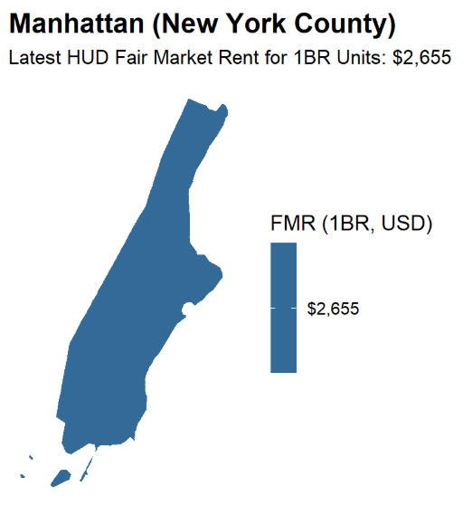
Geospatial Feature
Simple map of Manhattan (New York County) using {sf} + {tigris}
Displays the latest FMR value
All same colors because it’s Manhattan’s average price
Notes:
I also included a spatial visualization using sf and tigris, which was not covered in class.
This map displays Manhattan (New York County), the geographic unit at which HUD Fair Market Rent values are defined. Because FMR is calculated at the county level, the map highlights the jurisdiction to which the rent estimate applies rather than variation within the county.

Slide 12
Key Takeaways
Manhattan rents have risen steadily for a decade
Free market forecast reaches $3,000+ by 2030
Rent stabilization reduces projected rents by around 14%
Rent freeze reduces projected rents by around 20%
Policy choices meaningfully impact future affordability
Notes:
The takeaways are straightforward: Manhattan rent levels are on a stable upward trajectory, and policy interventions can substantially shape future affordability.

Slide 13
Limitations
Forecasting model is descriptive, not causal
Market reactions to regulation not modeled
FMR and ZORI are proxies for actual rents
Neighborhood-level variation not included
Notes:
It’s important to acknowledge limitations.
This is not causal inference — the projections are hypothetical and do not reflect supply-side or behavioral changes.
Still, it offers a useful illustration of the potential magnitude of policy impacts.

Slide 14
Conclusion
Rent policy materially affects projected rent levels
Even modest regulation significantly slows rent growth
Scenario modeling offers valuable insight for public policies discussion
Notes:
In conclusion, the analysis shows that rent policy decisions can have a measurable effect on rent trajectories.
Scenario modeling like this can help guide discussions about affordability and housing policy.

Slide 15
Thank you!
Notes:
Thank you for listening

